Slide 1
Project management with Rstudio, git and renv
Ben Cooper

Slide 2
What is git?
Distributed version control system
Why use git?
Managing changes in medium/large projects
Providing a backup system for if things go wrong/get lost
Facilitating collaboration
Aiding code sharing and open science
Even data analysis and R scripts are a form of software development, and should be treated as such
Git can be integrated into RStudio via projects
GitHub is one of a number of remote repositories that Git can use

Slide 3
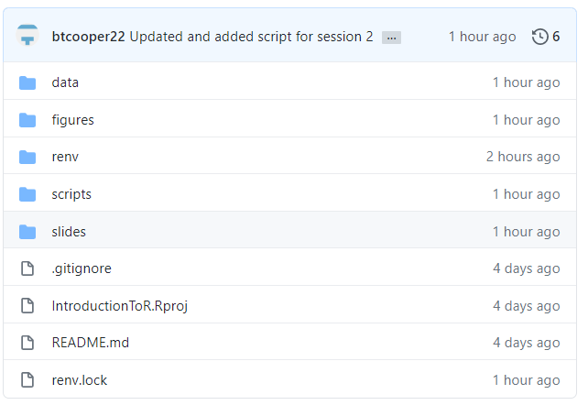
Getting started with git
Download git from https://git-scm.com/downloads
For various reasons, it’s better to create the repository on GitHub first, then connect RStudio
Other way round is totally doable too though
Start by cloning a repository
Downloading it locally, and syncing changes with the remote origin

Slide 4
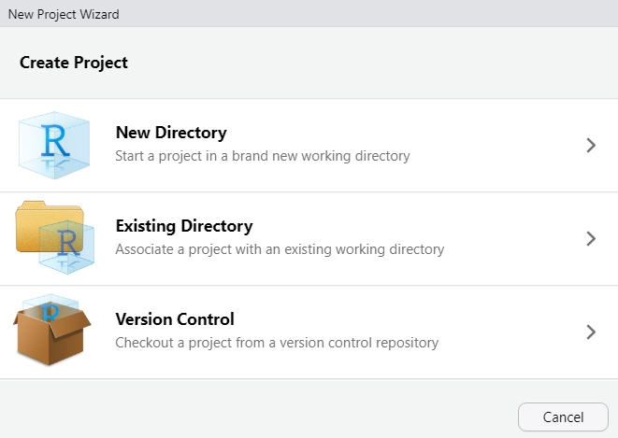
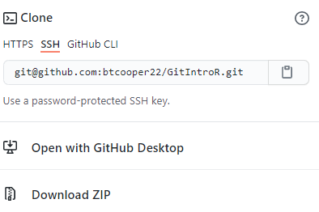
Starting an R project with git
File > New Project
Version control > Git
Enter URL from GitHub Repo
Advantages of R projects
Version control (obviously)
Reopens all previous scripts
Handles working directory and relative paths silently
Package management with renv

Slide 5

Package management with Renv
Each project gets its own library of R packages to avoid dependency issues
Produces a lockfile listing precise versions and sources of each package
Ideal for collaboration
Ensures future compatibility and reproducibility
Three main functions
Activate with init()
Update with snapshot()
Rebuild with restore()
Then continue using packages as normal

Slide 6
Core git workflow
Changes to files are then staged (prepared for committing)
Staged changes are then committed to the branch with a comment
No commit too small!
Commits are then pushed to the remote repository
New commits can also be pulled from the repository to the local project
Let’s try it out!

Slide 7
.gitignore
For files which are:
Large (>100 megabytes)
Sensitive (passwords / confidential data)
Unnecessary (logfiles, intermediates, preferences)
Files listed in the .gitignore file will be
Excluded from commits
Excluded from pushes to remote repositories
But their name and existence will be known

Slide 8
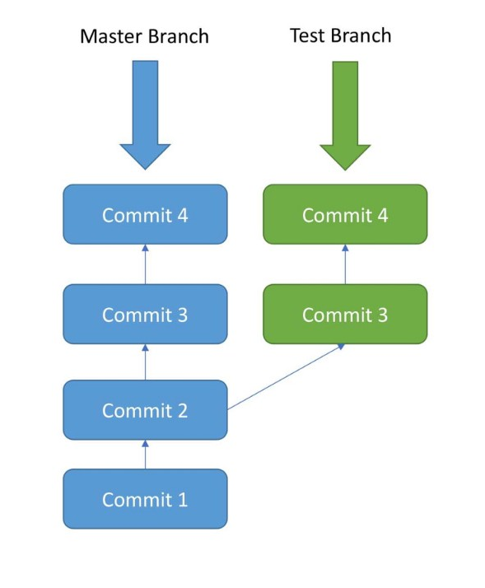
Branches
Represent parallel development
Branches are created off the main/master branch
Useful for testing new concepts or ideas whilst leaving the main branch intact
When desired, can be merged into the main branch by a “pull request”
Pull requests automatically check compatibility, and will inform if any elements of the main branch would be overwritten
Good practice to ensure the main branch remains a full and working version

